Slide 1
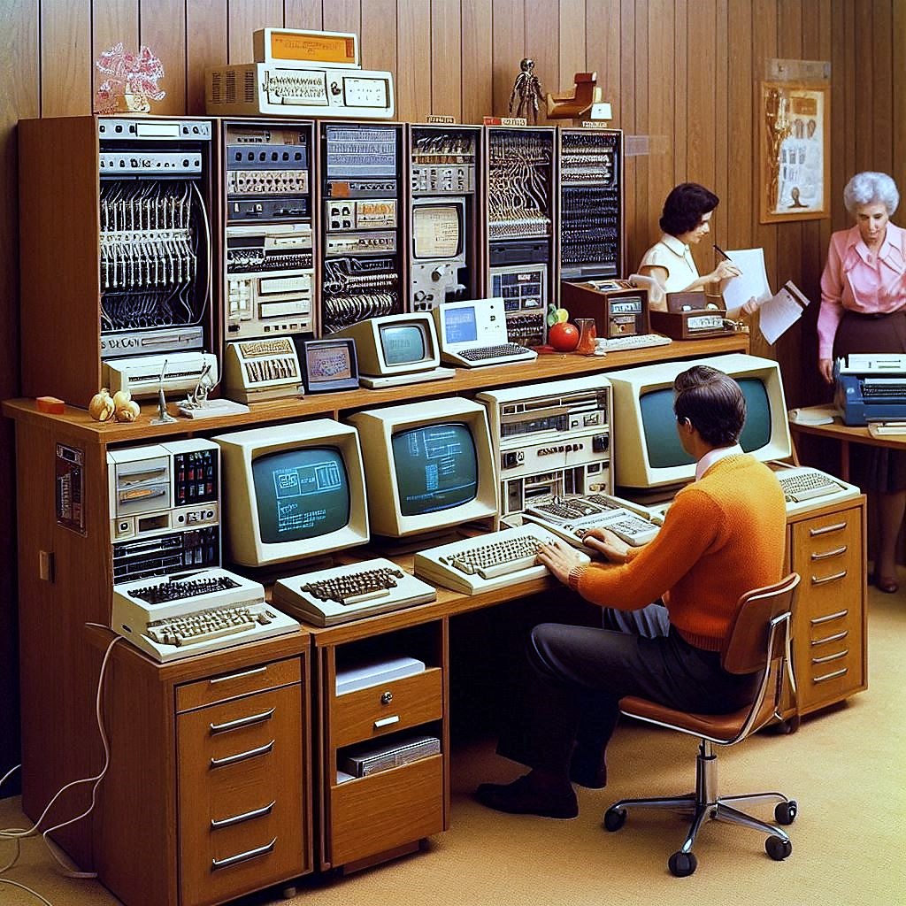
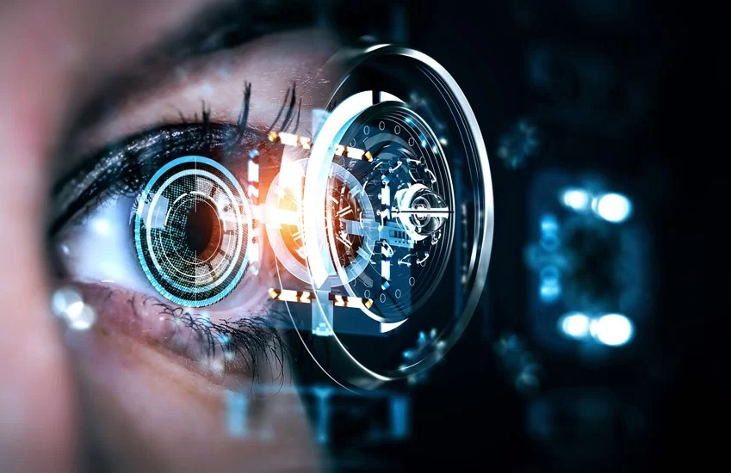
The
Evolution of Computer Vision
1970s – 1980s
Rubén Valenzuela
January - 2025

Slide 2
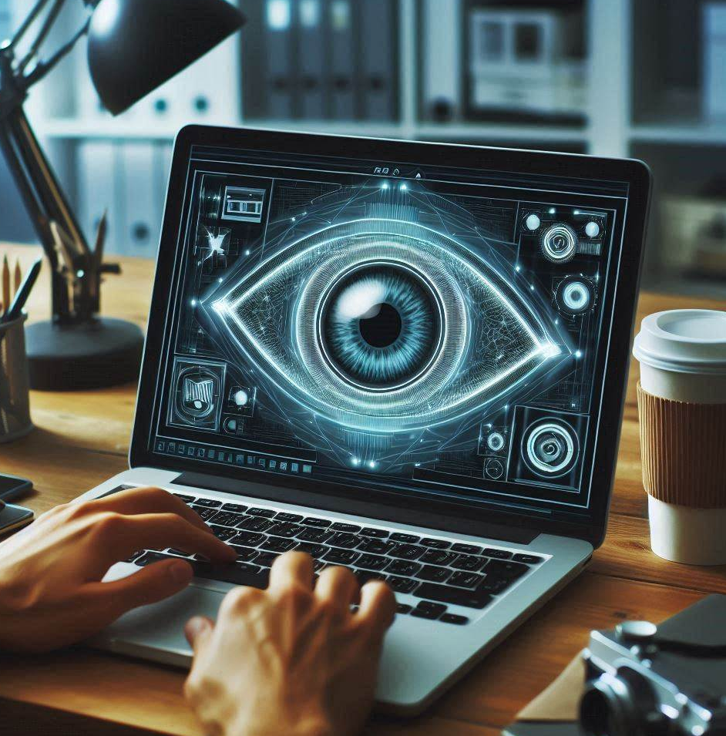
The Evolution of Computer Vision 1970s – 1980s
Introduction
INTRODUCTION
Computer Vision is a critical field in artificial intelligence that enables machines to interpret and understand the visual world.
This presentation focuses on key advancements made in computer vision during the 1970s and 1980s.
This era laid the groundwork for modern computer vision systems used today in self-driving cars, facial recognition, and medical imaging.

Slide 3

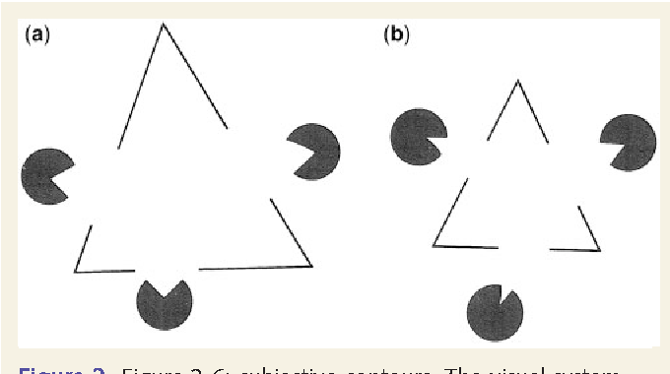
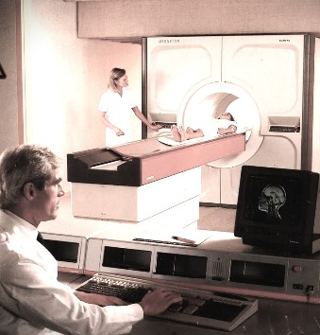
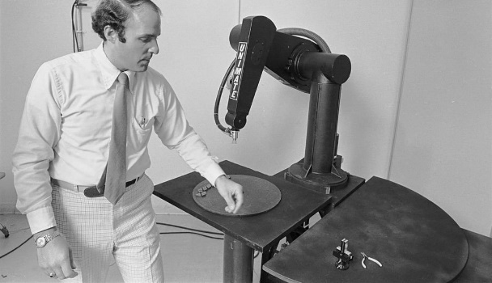

The Evolution of Computer Vision 1970s – 1980s
Timeline
Timeline
KEY MILESTONES
1970s
1980s
1980s
Late 1980s
DAVID MARR’S THEORY OF VISION
MEDICAL IMAGING SYSTEMS
INDUSTRIAL ROBOTICS
JOHN S. LIM’S
OBJECT RECOGNITION ALGORITHMS

Slide 4
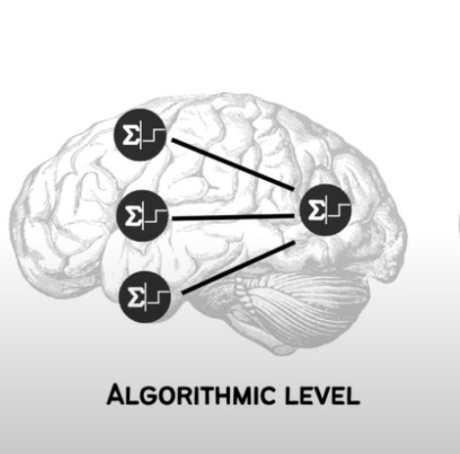
The Evolution of Computer Vision 1970s – 1980s
Key Advancements
KEY ADVANCEMENTS
IN THE 1970S-1980S
David Marr’s Theory of Vision (1970s):
David Marr proposed a computational model for understanding how the brain processes visual information, which became a cornerstone for computer vision.
David Marr's
Theory
Read More

Slide 5
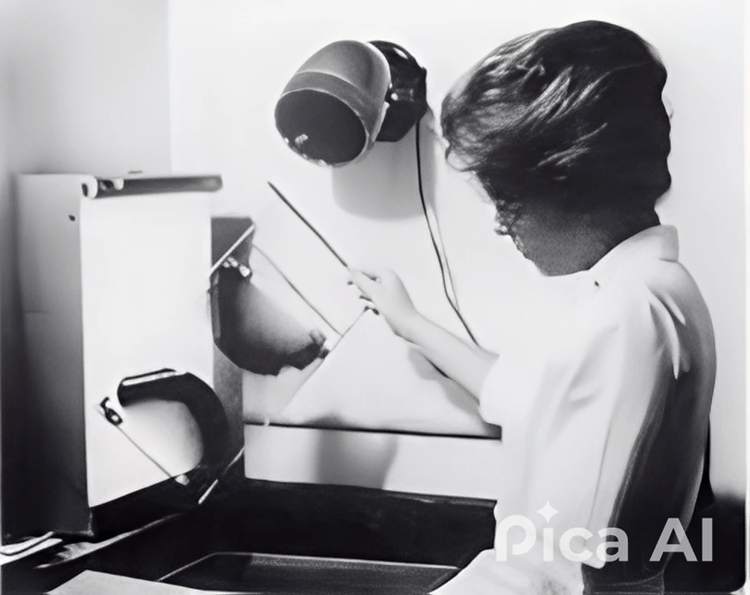
The Evolution of Computer Vision 1970s – 1980s
Key Advancements
MEDICAL IMAGING
SYSTEMS
(1980s)
Mammograms
Computer vision was used to analyze medical images, leading to advancements in tumor detection and diagnosis

Slide 6
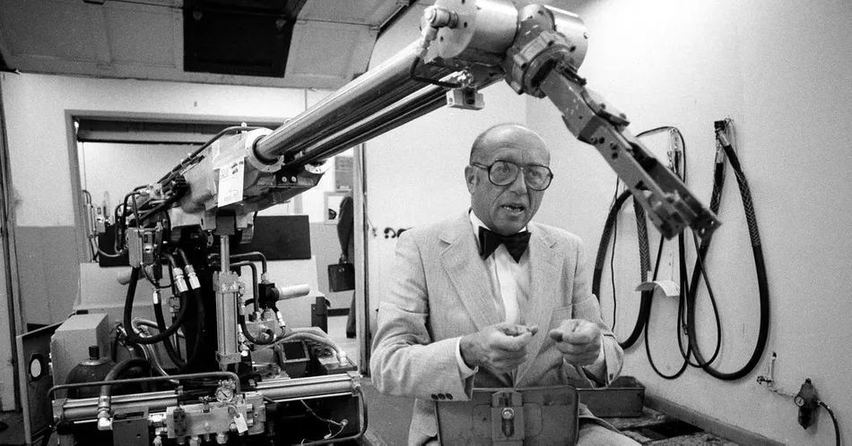
The Evolution of Computer Vision 1970s – 1980s
Key Advancements
INDUSTRIAL ROBOTICS
(1980s)
Robot
Assembling Parts
Vision systems were integrated into industrial robots, enabling automated assembly lines in industries like automotive manufacturing.

Slide 7

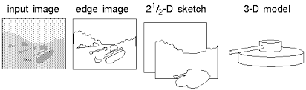

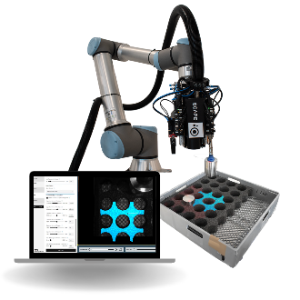
The Evolution of Computer Vision 1970s – 1980s
Influential Figures
INFLUENTIAL FIGURES
(1970s – 1980s)
David Marr
John S. Lim
(1945-1980)
(Late 1980s)
Marr’s work in the 1970s on how vision is processed computationally transformed the field of computer vision and has had lasting influence
John S. Lim developed algorithms that improved 3D object recognition, making computer vision systems more accurate in industrial and real-world applications.

Slide 8
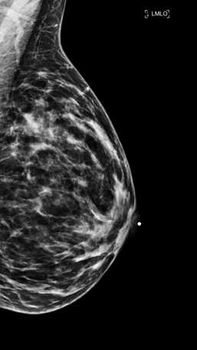
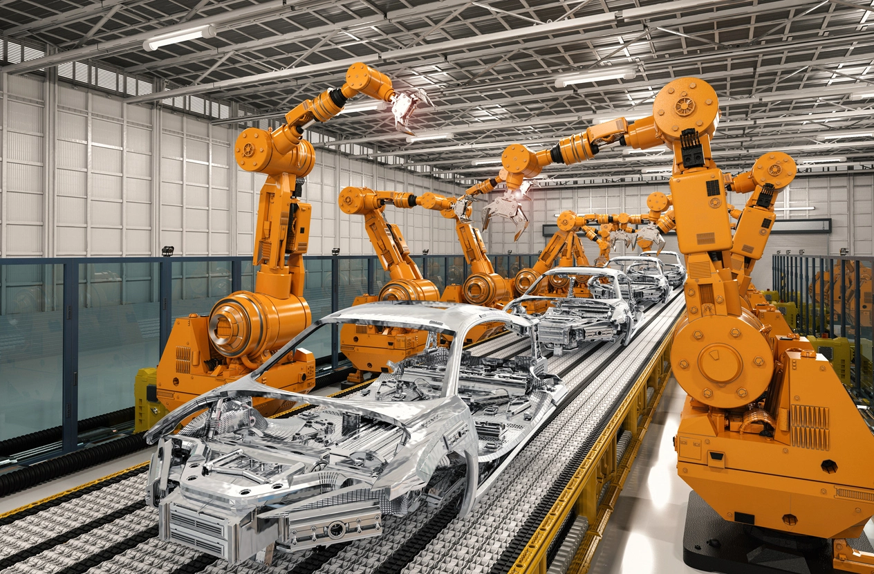
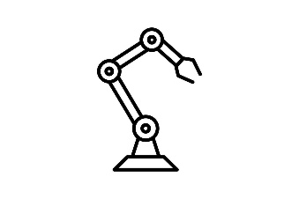

The Evolution of Computer Vision 1970s – 1980s
Early Aplications
EARLY APLICATIONS
OF COMPUTER VISION
Medical Imaging
Industrial Robotics
In the 1980s, computer vision enabled advancements in medical imaging, such as automated tumor detection in mammograms, which revolutionized healthcare diagnostics.
Robots in manufacturing used vision systems to inspect parts, making assembly lines faster and more efficient.

Slide 9
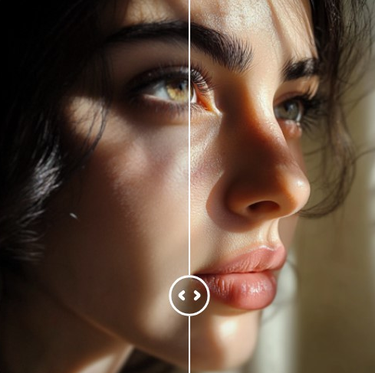
The Evolution of Computer Vision 1970s – 1980s
Challenges
CHALLENGES IN THE 1970s – 1980s
Technical
Challenges
Breakthrough Solutions
Despite progress, early computer vision systems faced challenges such as poor image resolution, lighting conditions, and computational limitations.
Researchers worked on techniques to normalize lighting and improve the processing power needed to handle more complex tasks.

Slide 10
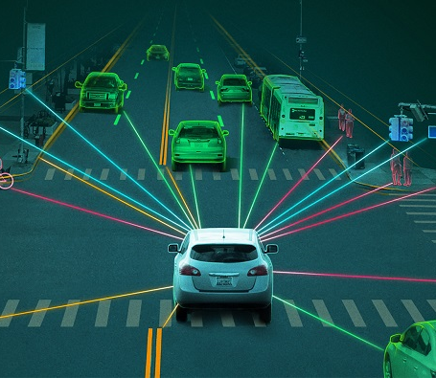
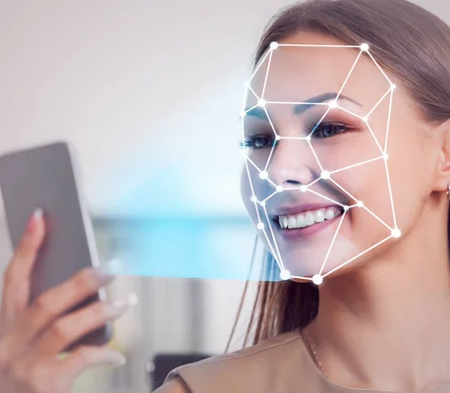
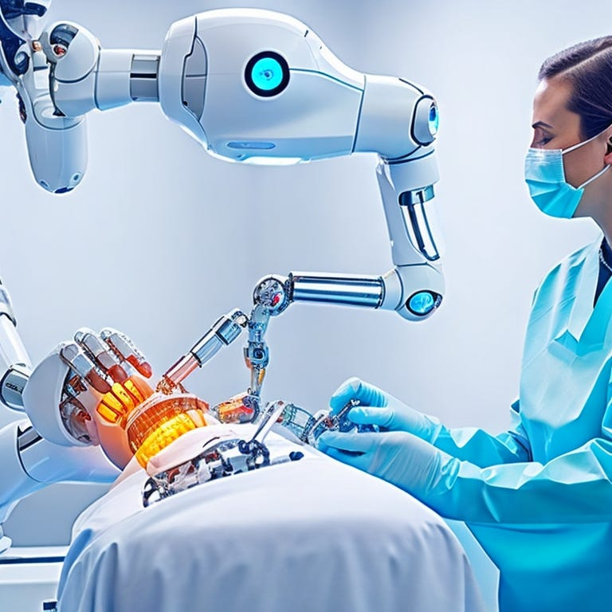
The Evolution of Computer Vision 1970s – 1980s
Modern Impact
Autonomous Vehicle
Facial Recognition
MODERN IMPACT AND LEGACY
The advancements made in the 1970s and 1980s have had a lasting impact on modern applications like facial recognition, self-driving cars, and robotics.
Without the foundational work of vision systems in the 1980s, today’s AI-driven technologies wouldn’t be possible.
AI in
Medicine

Slide 11
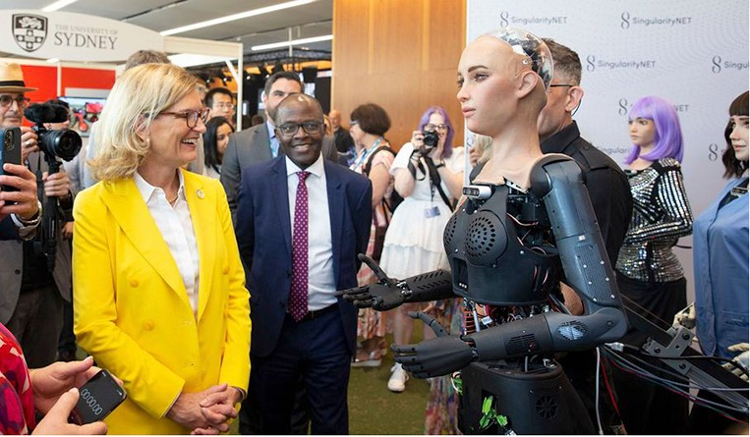
The Evolution of Computer Vision 1970s – 1980s
Conclusion
CONCLUSION
The 1970s-1980s were a crucial period in the development of computer vision. Key advancements, such as Marr’s theories and early practical applications in medical and industrial fields, laid the groundwork for today’s AI systems.
The legacy of this period continues to shape the future of AI and computer vision technologies.

Slide 12
The Evolution of Computer Vision 1970s – 1980s
Questions
QUESTIONS
& ANSWERS
?
Any Questions

Slide 13
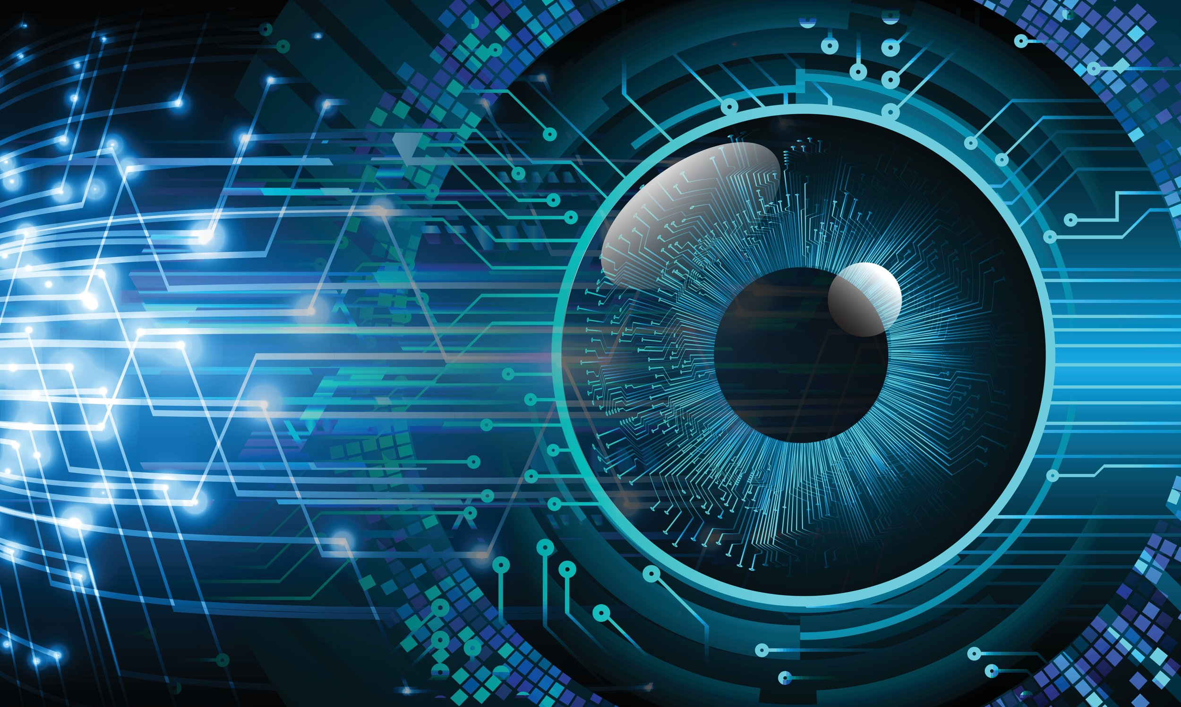
THANKS FOR WATCH

